Slide 1
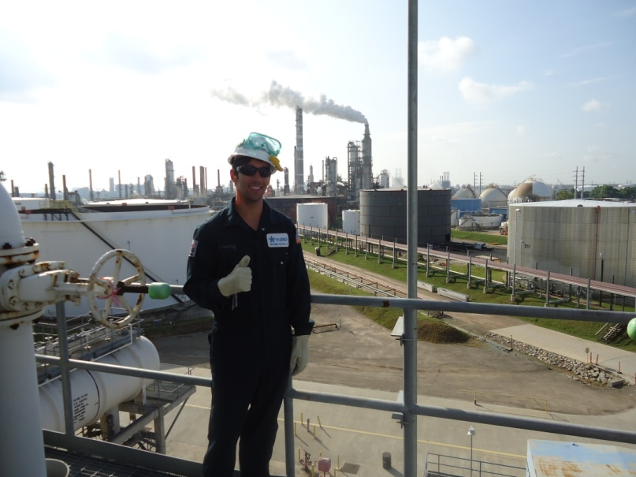
Valero-Houston Process Engineering Internship 2013
Luke Smith
Texas A&M University
Chemical Engineering, Class of 2014

Slide 2
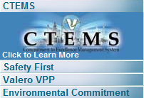
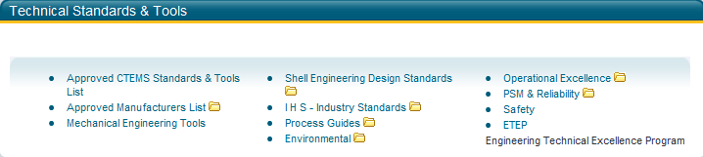
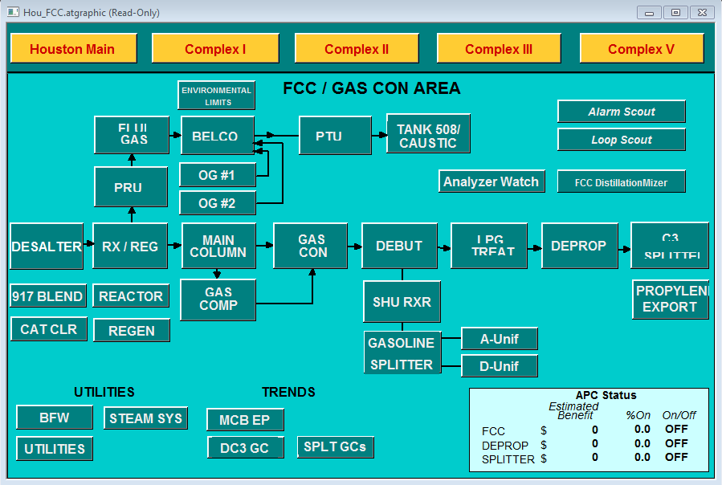
Overview
Projects
  Coalescer Action Item
  Incinerator B Refractory
  Depentanizer Test Run
  FCC Absorber Chiller
  EIV Mapping
Learning
  Unit Process Overviews
  Key Business Drivers
Tools
  HYSYS Simulations
  InfoPlus, LabWorkbench, etc.
  Industry Practices

Slide 3

FCC Absorber Chiller
Problem Statement
  Recover propylene from Shell off gas
  Propose chiller installation, determine effectiveness
  Tools used: HYSYS, P&IDs, IP21, LabWorkbench
Objectives
  Understand Absorber/Stripper process
  Common optimization issues
  Chiller duty calculation over absorber

Slide 4
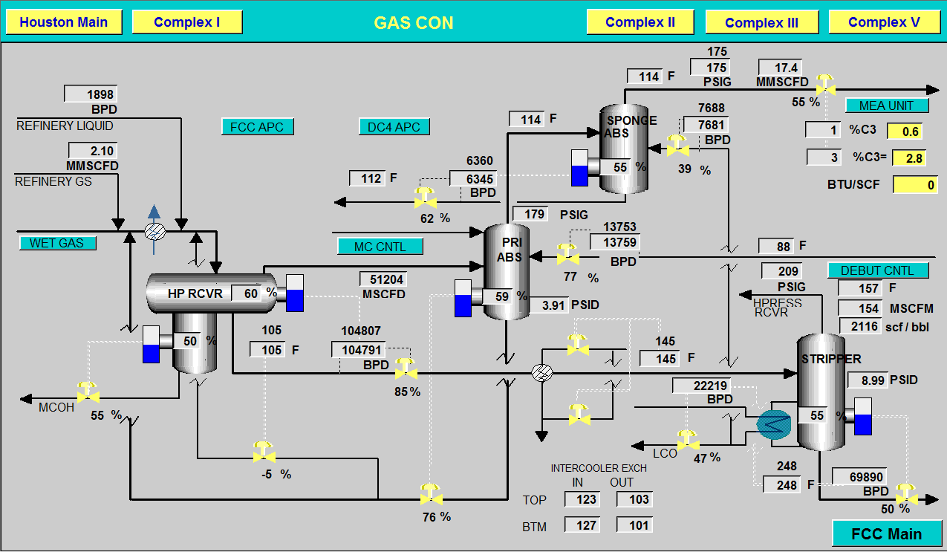
FCC Absorber Chiller

Slide 5
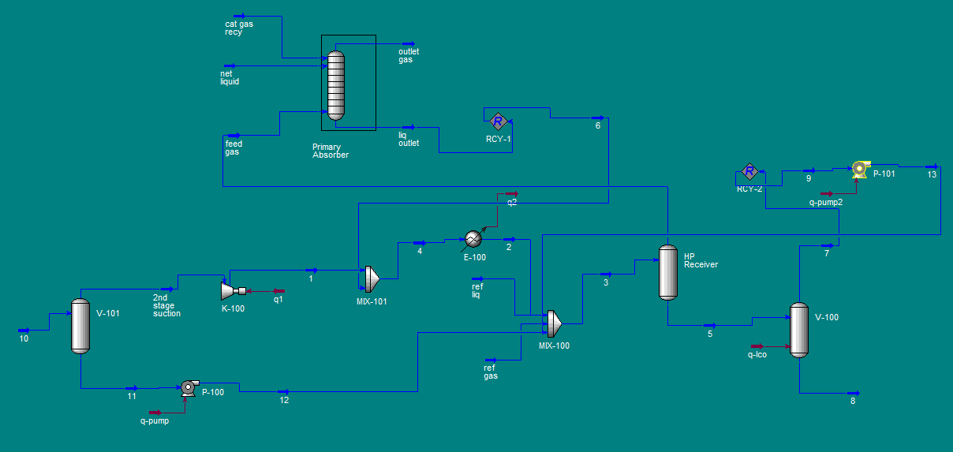
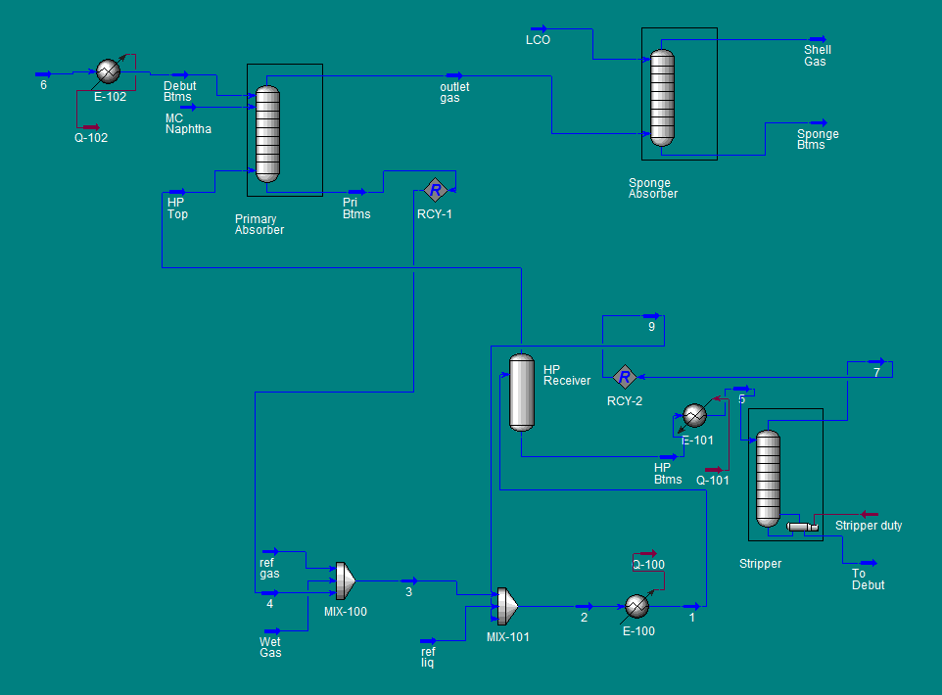
Results
  Started with model used in other project
  Made modifications
  150 ton chiller required
  Quote pending

Slide 6
FCC Absorber Chiller
Financial Justification
  Refinery Grade Propylene (RGP) value: 41.5₵/lb
  Shell off-gas propylene price: 10.4₵/lb
  Barrels propylene in off gas per day: 360BPD
  Total loss due to discount: $20,000/day
  Duty applied to Debutanizer stream: 150 tons (1.8MMBTU/hr)
  Increase in propylene recovery: 100BPD
  Revenue generated: $5600/day
  Estimated project cost: Awaiting quote

Slide 7
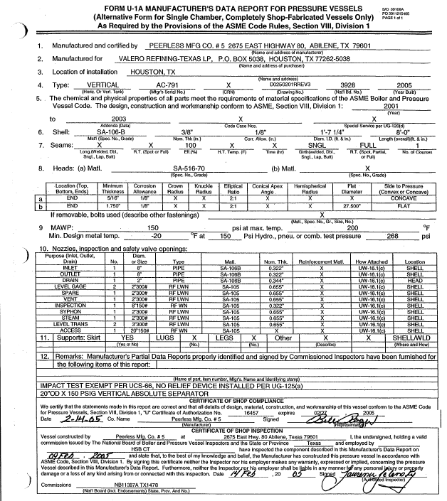
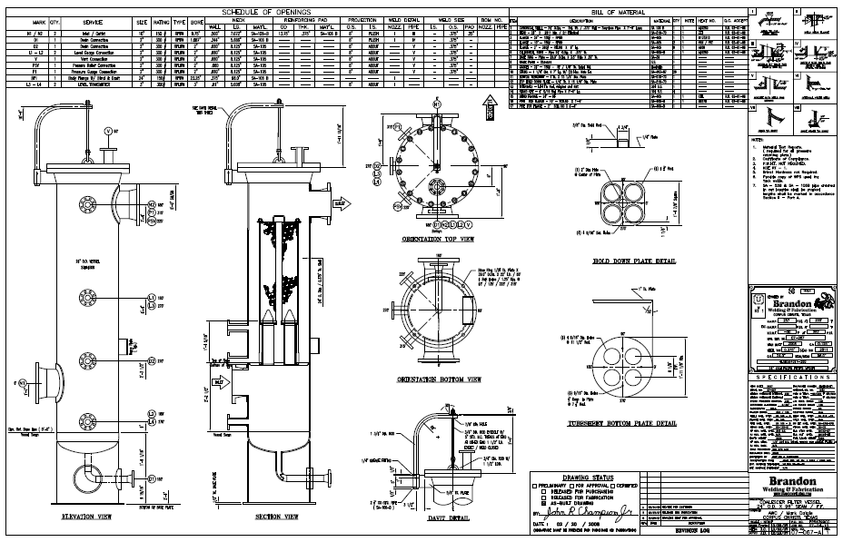
Coalescer Action Item
Confirm proper sizing of all fuel gas coalescers
  First assigned project
  Boiler tip plugging
  Tools used: Shell DEP, IP21, P&IDs, Excel, Vendor

Slide 8
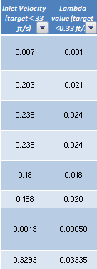
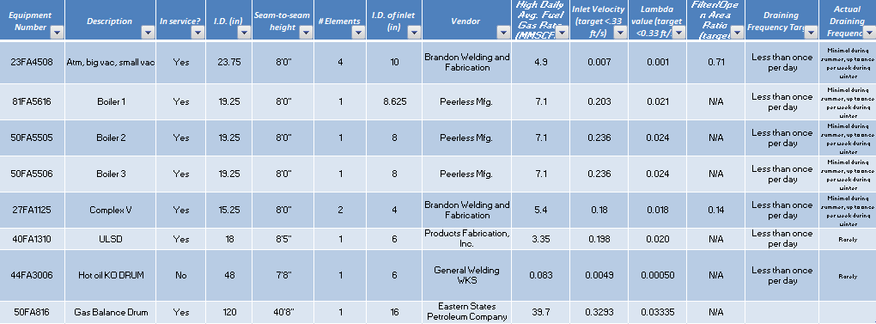
Coalescer Action Item
Procedure
  Find all fuel gas coalescers
  Lambda value, area ratio, velocity
  Draining frequency
  Action item write-up
Results
  All properly sized
  Fouling due to bypassing
  Action item closed on time
λ=(Q_{G}/A_{G})*√ρ_{G}/ (ρ_{L}- ρ_{G})

Slide 9
Incinerator B Refractory
Problem Statement
  Determine steel skin temperature on incinerator B stack
  Currently out of service
  Tools used: Excel, Textbook, P&IDs, SME, Vendor
Objectives
  Basis for inspection
  Understand results of inspection
  Adjustable excel tool

Slide 10
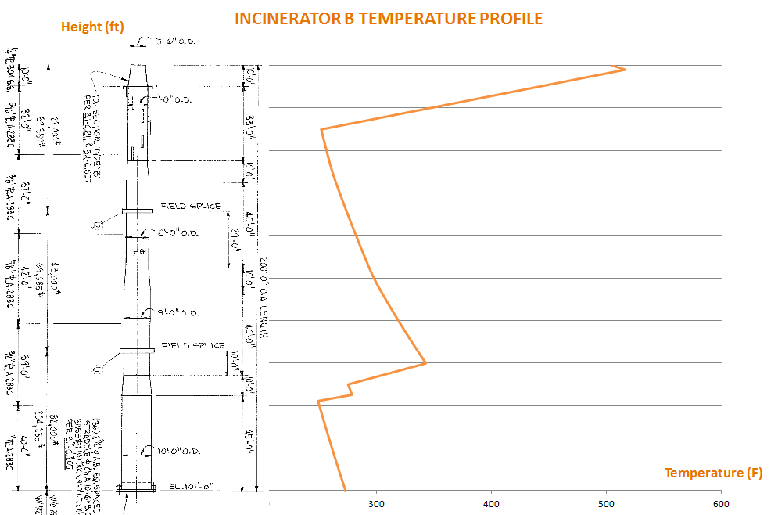
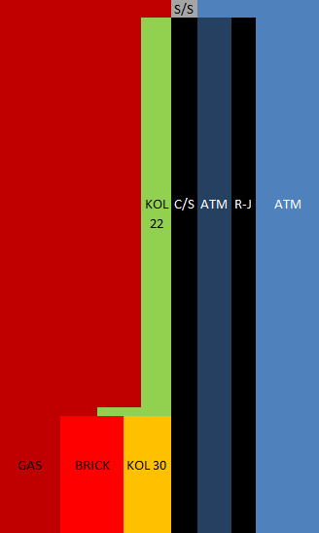
Incinerator B Refractory
  The transition points between types of refractory cause a dramatic increase in temperature, creating potential hot spots.

Slide 11
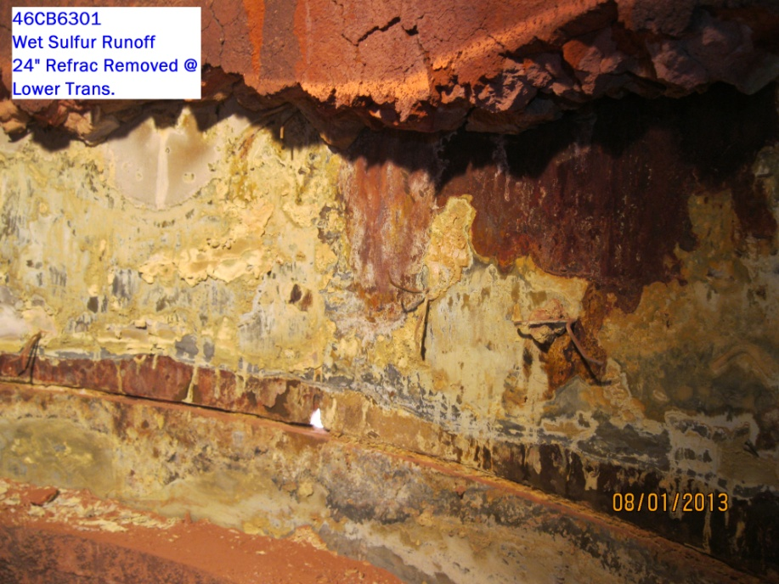
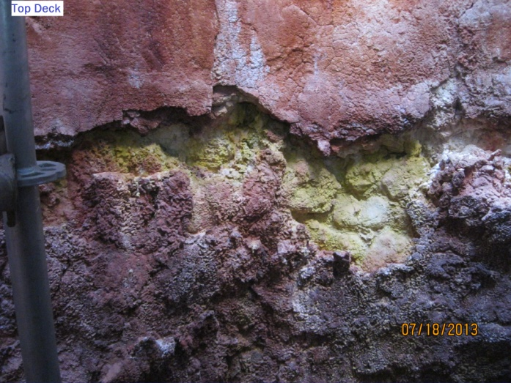
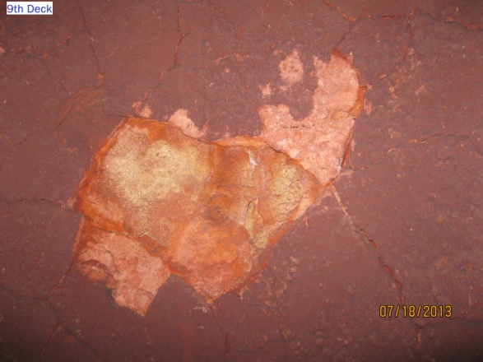
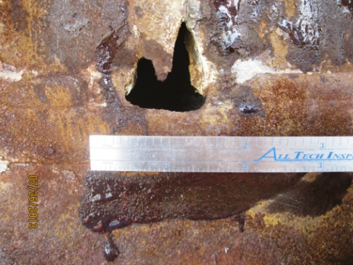
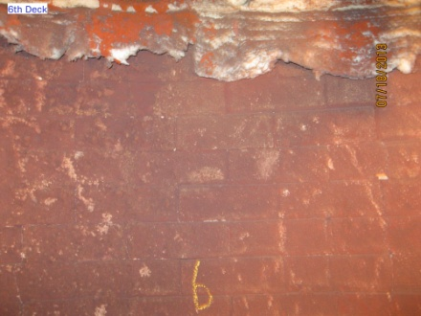
Incinerator B Refractory
Inspection Pictures

Slide 12
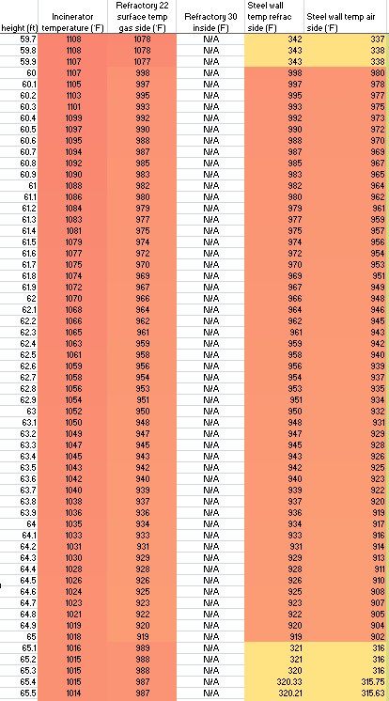
Incinerator B Refractory
Results
  Refractory missing near 60’ flange
  Metal temperature up to 1000°F
  Above carbon steel melt point
  Must replace refractory
998°F

Slide 13
What I Learned
Flows and Fundamentals
  First things an associate process engineer needs to know
  Safety throughout refinery
  Preparation for projects
Meaningful Projects
  The “deliverable” in every project
  Inter-department coordination
  Use of tools such as HYSYS, DEP, Excel, G-Drive

Slide 14
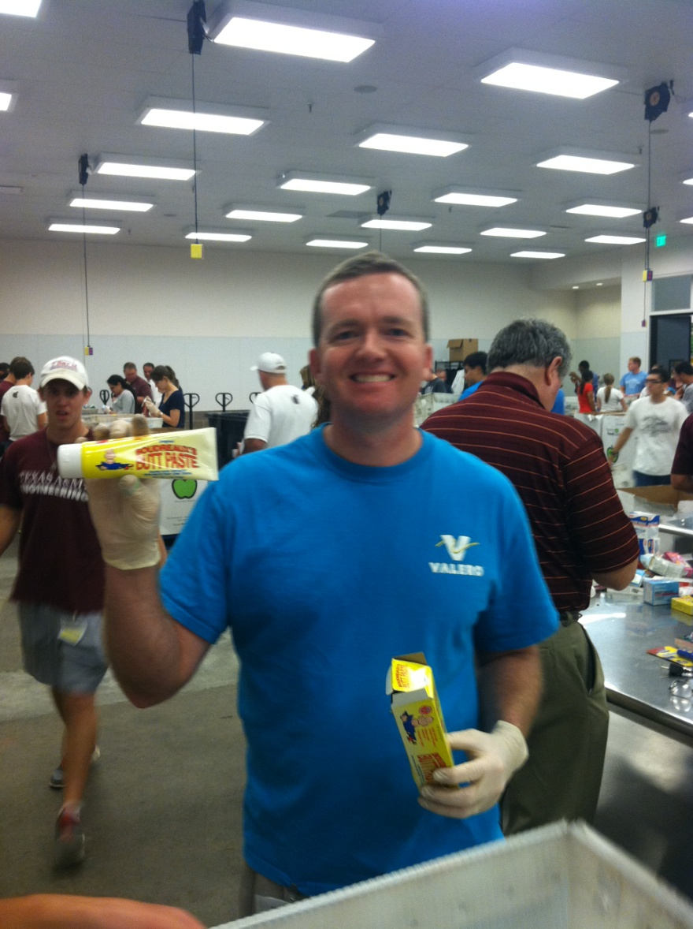

Slide 15


Questions?
Don
Thank
You!
Evan
Brent
Tech Services
Interns
Leo
Jen
Rick
Justin
Jon
Marty
Chris
Jonathan
Josh
David
Stephen
Jeff

