Slide 1
Production of Human Growth Hormone
Luke Smith, Nathan Westbrook, Cara, Jack

Slide 2
Background– Early Development
Human growth hormone (hGH or HGH) first introduced in the 1950s
Intended to cure dwarfism and other childhood growth defects
Early uses required cadavers since recombinant DNA technology was not available
http://zmcelroy.tripod.com/sitebuildercontent/sitebuilderpictures/achondroplasiacomparison.jpg

Slide 3
Background-- Modern Uses
Modern uses- childhood defects, injuries, reverse aging as well as athletic enhancement
Some ethical concerns, especially in sports
HGH is produced naturally in the body, so testing is difficult
http://www.midwestsportsfans.com/wp-content/uploads/2009/02/mark-mcgwire.jpg
http://2.bp.blogspot.com/-y0iwHXLlPVQ/UJqfYOugckI/AAAAAAAAANY/8hSLPn4PraI/s1600/HGH+Pills+Are+Effective.png

Slide 4
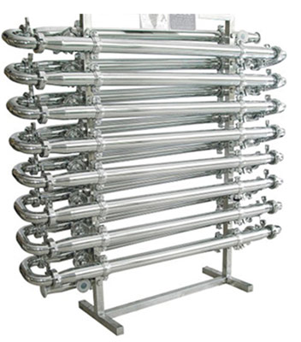
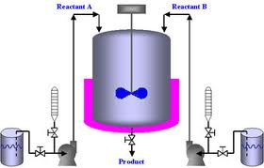
Background-- Biological Industry
Recombinant DNA
Plug Flow or Fed Batch Reactor
World market size projected at over $4 billion in 2018
Design calculation to meet projected demand
http://www.stamixco-usa.com/images/products/enlarge/P-13.0)-Plug-Flow-Reactor(68rrr3).jpg
http://24x7support.biz/api/fed-batch-reactor-design-i7.jpg

Slide 5
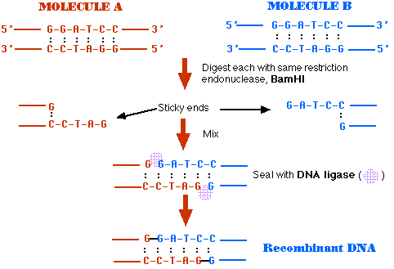
Background-- Questions to Address
How can we best design a system to produce HGH?
What are the operational procedures of this process?
What are the current limitations of this process?
Best Process?
http://users.rcn.com/jkimball.ma.ultranet/BiologyPages/M/Making_rDNA.gif

Slide 6
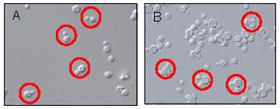
Design-- Reaction
Typically, E. coli or P. pastoris cells are used
Substrates vary (usually simple CHO molecules with nitrogen-containing supplements)
Conversion of simple substrate to a very complex 191-amino acid, single chain polypeptide
http://www.microbialcellfactories.com/content/figures/1475-2859-5-S1-P69-1-l.jpg

Slide 7
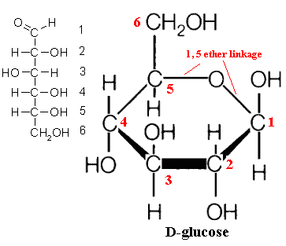
Design-- Recombinant DNA
DNA of E. coli/P. pastoris is modified to allow for HGH production
2 plasmids (T-7 based pET expression plasmid, pGP1-2) absorbed into cell as inclusion bodies by heat treatment.
These plasmids allow cells to produce HGH from glucose
http://palaeos.com/fungi/fpieces/images/Glucose.gif

Slide 8
Design-- Lab Scale production
Genetically modified cell culture grown in Luria-Bertani (LB) Medium
Cells then transferred to a fermentation flask maintained at 30degC, pH=6.9, dO2=.25
u_max generally between 0.22-0.24 (h^-1)
Yields around 0.6 gCells/gSubstrate
Product yields around .004 g(rhGH)/gSubstrate

Slide 9
Design-- Industrial Scale Production
Both Fed-Batch and Plug Flow Reactors commonly used
Many different substrates (methanol, glucose, glycerol, dextrose, etc.)
u_max around .15 (h^-1)
Many undesired products (often other proteins) are formed.

Slide 10
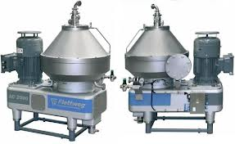
Design-- Separations
First, cell mass is separated from substrate/product solution via centrifugation
Next, chromatography is used to separate rhGH from the substrate/product solution
Low Yields, final rhGH concentration around 0.5 (g/L), 50 grams of rhGH from a batch in a 100L reactor!
http://img.directindustry.com/images_di/photo-g/centrifugal-separator-for-the-chemical-industry-28713-2821039.jpg

Slide 11
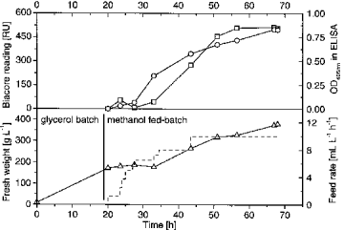
Operation-- Preparation
4 Stages: Batch, Fed-batch, Induction, Separation
75 liter bioreactor (50L production volume)
Inoculation of Pichia pastoris from yeast extract (initial cells)
Peptone and Dextrose (YPD) medium
http://www.babonline.org/bab/030/0267/bab0300267f03.gif

Slide 12
Operation– BATCH AND FED-BATCH
After 24 hrs, media is transferred to 500mL Basal Salt Medium (BSM)
Culture is incubated for 7 days before use in 75L reactor
Fed-batch stage follows with the addition of 630 g/L substrate glycerol
The final cell concentration (dry weight) was around 150 g/L (quassi steady-state achieved)

Slide 13
Operation– iNduction And separation
Methanol is fed to induce the production of hGH after the end of exponential feed period with approximately 0.033 g methanol/g cell/hr
Induction phase lasts 4 days
The final concentration of total protein was 1.1 g/l and the final concentration of hGH was around 0.5 g/l.
Separation: fermentation medium is centrifuged for 20 minutes

Slide 14
Limitations– Reactor Type
Fed Batch Reactor used in calculation
Cannot produce product continuously
May cause problems when demand increases since batch processes usually require more downtime

Slide 15
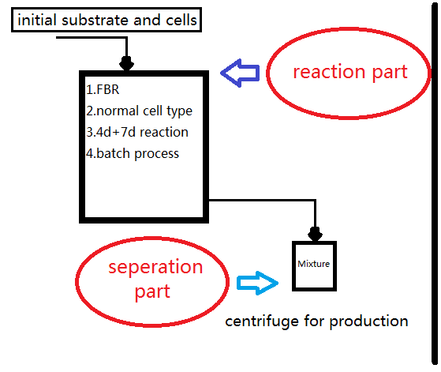
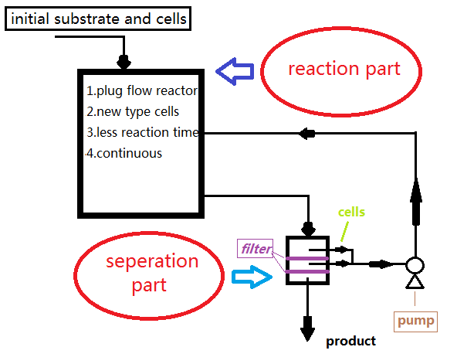
VS
VS

Slide 16
LIMITATION– batch PHASE
7 day batch phase limits quantity produced
Two-medium system currently used. Incubation in BSM is slow.
Could either change cell or medium

Slide 17
LIMITATION– INDUCTION PHASE
4 day induction phase limits quantity produced
Many different cells used today (e. coli, Pichia pastoris, others)
There is not yet a best practice, research more efficient cell options

Slide 18
√

Slide 19
References
N. Frank, A.M. Simao-Beaunoir, M.A. Dollard, P. Bauda. “Recombinant plasmid DNA mobilization by activated sludge strains grown in fixed-bed or sequenced-batch reactors.” http://www.sciencedirect.com/science/article/pii/0168649696000530. October 1996.
Sarunya Poma , Chanon Sattayarom , et al. SCALE-UP FERMENTATION STUDY OF RECOMBINANT Pichia pastoris FOR PRODUCTION OF HUMAN GROWTH HORMONE IN A GMP-COMPLIANT PILOT FACILITY. Biopharmaceutical Facility, Industrial Park, King Mongkut’s University of Technology Thonburi, Bangkok 10150, Thailand.
J. M. Tanner. Nature, Vol. 237. “Human Growth Hormone” http://www.nature.com/nature/journal/v237/n5356/pdf/237433a0.pdf. June 23, 1972.
Nidhi Uppangala. “The Production of Human Growth Hormone Somatotropin.” http://www.biotecharticles.com/Biotechnology-products-Article/Production-of-Recombinant-Human-Growth-Hormone-Somatotropin-367.html. August 8, 2010.

